Slide 1
Your Pitch Deck Title Slide
Your Company Name
Today’s date

Slide 2
THE ELEVATOR PITCH
In one sentence, answer:
What’s the problem and solution (product/service)?
What is the value proposition?

Slide 3
THE PROBLEM/CURRENT SOLUTIONS
What is the problem to be solved or the unmet need you are solving?
Clearly define the pain or the strong need that is currently unfulfilled.
Basically, the idea is to show that there is a technology that solves an actual problem that is being experienced in the market instead of finding a market to fit a cool technology.

Slide 4
MARKET OPPORTUNITY
What is the Total Addressable Market?
Define your target customers and their key characteristics.
Ex. Consumers vs. enterprises
What is the current demand and what are the unique needs?
This is a look at the size of the market, how fast it’s growing, and the factors and trends affecting it that the solution addresses.

Slide 5
THE SOLUTION/DEMO
Show > Tell
1 to 2 slides of your product/service
Show screenshots of key parts
Provide an example of a prospective customer
Show the core value proposition to a customer (better, faster, cheaper)
Describe what the product/service does, the benefits (not the features), and value the customer will receive (how much in $ does the customer’s current problem cost them?).

Slide 6
MARKET FIT/COMPETITION
Show product market fit.
List direct competitors versus indirect competitors
Why will customers switch to you versus the incumbent?
Are you changing customer behavior?
What is the hypothesis of the solution? Provide key insights on your target market.

Slide 7
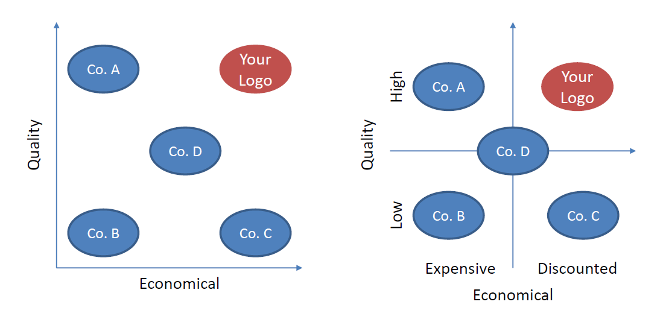
MARKET LANDSCAPE (example 1)
A picture is worth 1,000 words!

Slide 8
COMPETITIVE ADVANTAGE
Current competitive advantage
Sustainable competitive advantage?
Patents?
IP beyond patents, i.e., data, trade secret?
Key relationships/partnerships?
Barriers to entry?
Competitors’ competitive advantage/weakness?

Slide 9
SALES & MARKETING
What is the plan for reaching the target market?
Channels: how to reach/market to customers?
Strategy: how to convert, acquire, or close customers?
Unique strategic relationships/partnerships?
Scalability to grow fast economically?

Slide 10
REVENUE MODEL
How do you make money? Key revenue streams?
Pricing? Flat fee or %? What is that %?
Recurring revenue frequency?
High volume or low volume business?
Show basic math:
100 customers x A Units x B Fee = $C Revenue

Slide 11
EXPENSE MODEL
Key expenses/time/efforts needed to generate revenue
Cost of goods sold
Monthly burn rate (now versus after funding)

Slide 12
FINANCIAL PROJECTIONS
# of years projected
Show total # of customers per year and % market penetration
High-level finances
Revenue, COGS, gross profit, operating expense, EBITDA

Slide 13
CAPITAL RAISE & USE OF PROCEEDS
The Ask: How much capital are you looking to raise?
Average monthly expenses – how long will the new investment last (runway)?
Any prior investment rounds?
SBIR/STTR/Other non-dilutive funding
Use of proceeds (name it & give $ amount)
Use to achieve key milestones: build a prototype for a demo, acquire customers, etc.

Slide 14
THE TEAM
Core team: the founders and chiefs
Leadership experience
Education
No more than 3 bullets per person
Board of Advisors (if formed yet)
How do they help, other than being a big name? Are they investing?

Slide 15
Your Company Logo
Contact info: Name/email/phone

